Slide 1
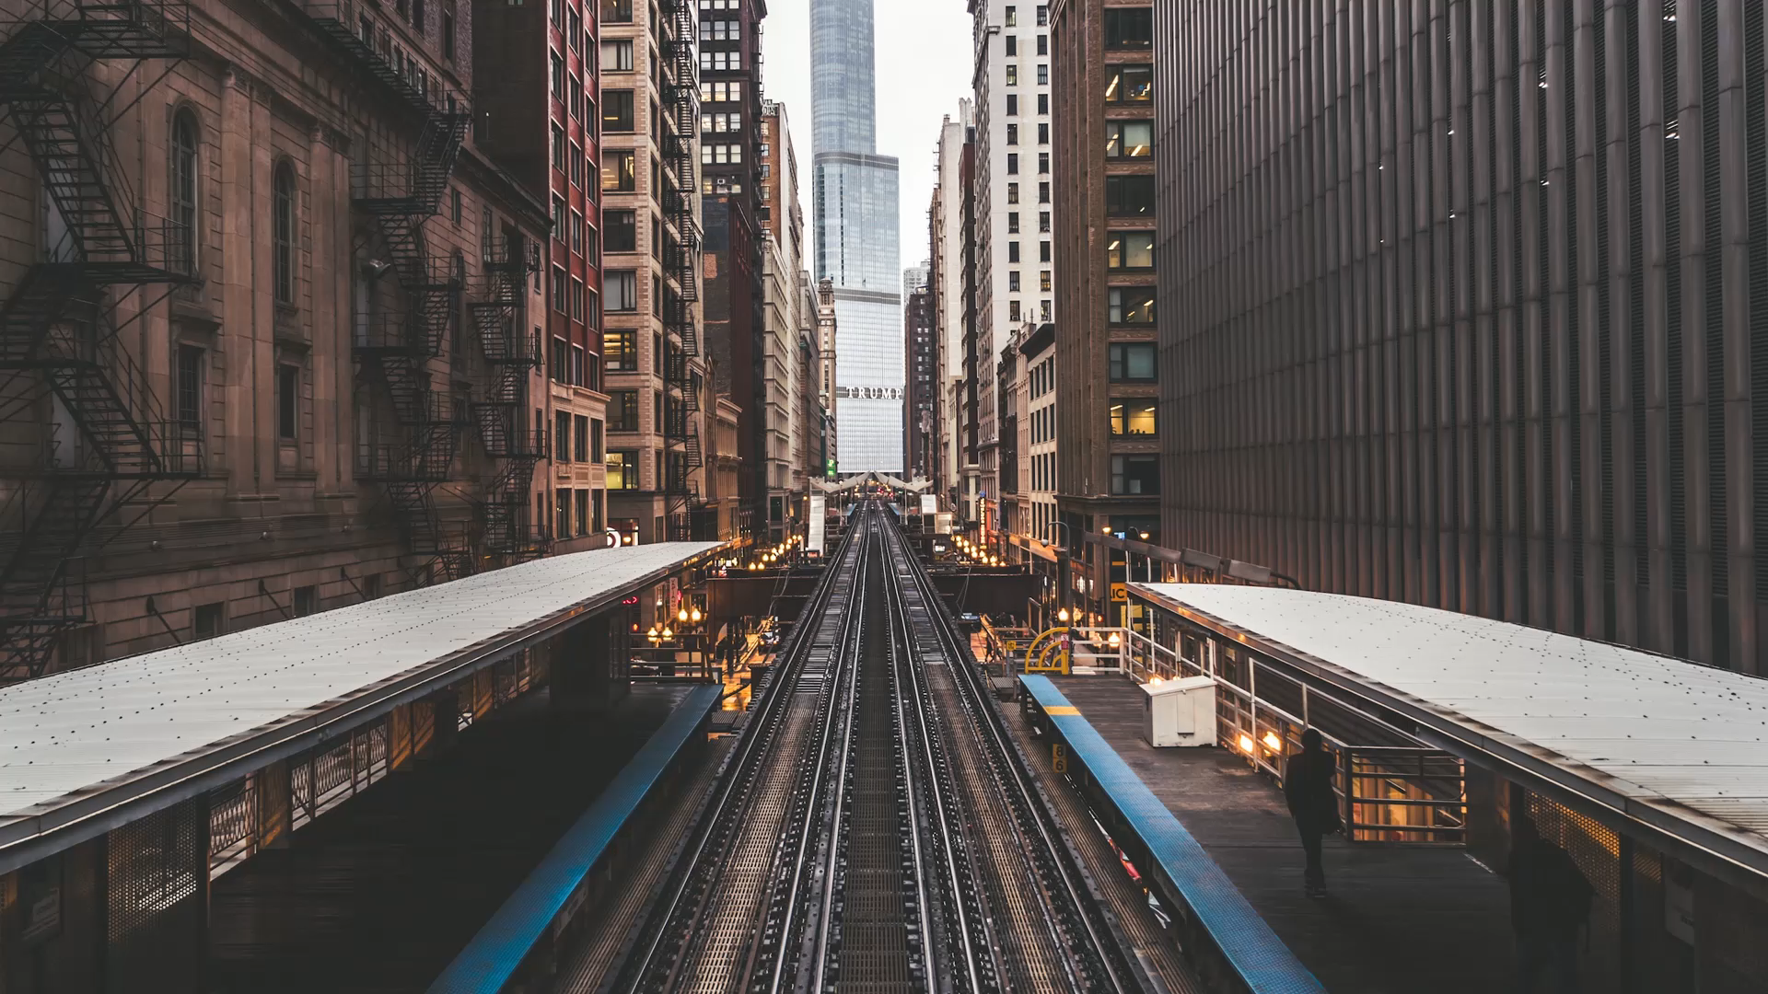
Timing is everything
Design and Analysis of Operations Research Methods for Optimization of Rail Network Traffic

Slide 2
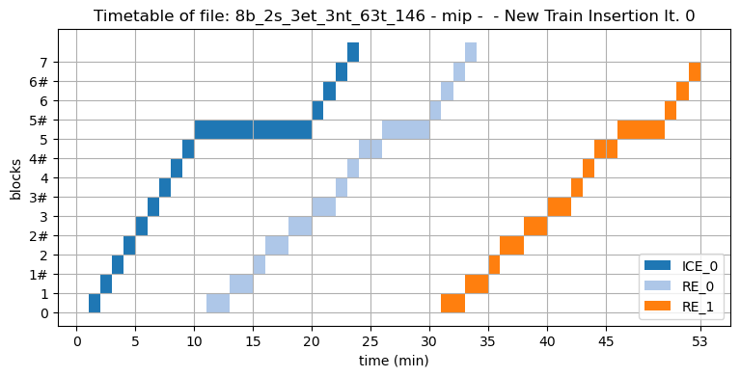
Setting
Train traffic on a single line
Existing schedule of trains
Notes:
More about regional, but long distance lines (regional traffic, lines between cities)

Slide 3
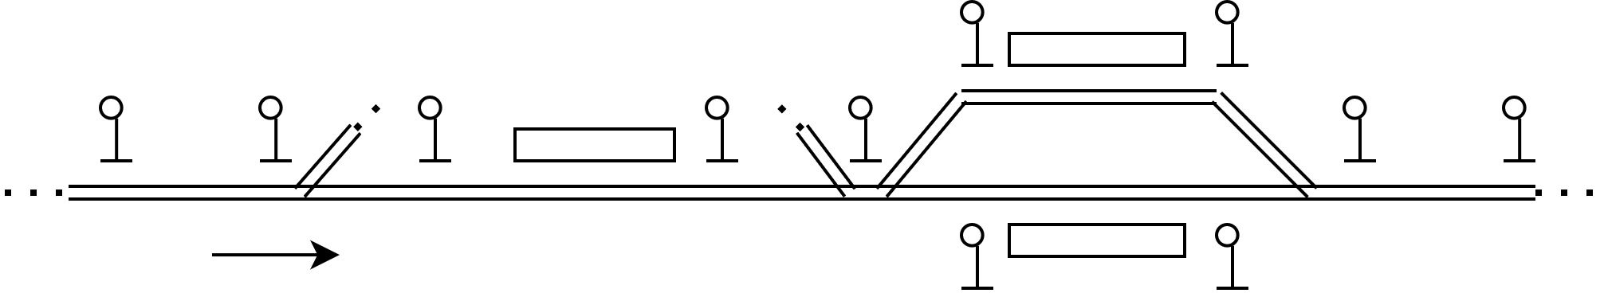
Example Train Network

Slide 4
Signal blocks
Station blocks
Switch blocks
Notes:
Gleise
Abbildung nicht Maßstabsgetreu!

Slide 5
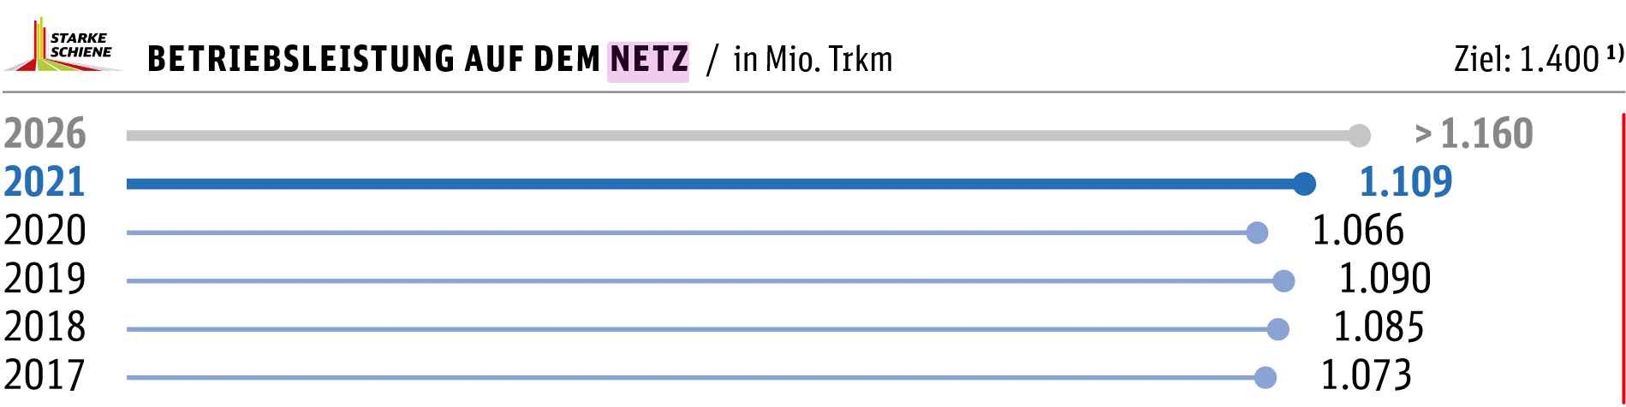
Motivation (delivered by DB)
Every day 23505 trains are traveling on the german railway network
1109 million km travelled
1,203 billion* passengers per year
3,9 million passengers per day
A high potential for optimisiation!
Notes:
\* english Billion = german Milliarden
Source: Deutsche Bahn Daten und Fakten 2021, https://www.deutschebahn.com/resource/blob/7537106/7d38dfcb4de528171002c09ae29ba705/DuF2021-data.pdf

Slide 6
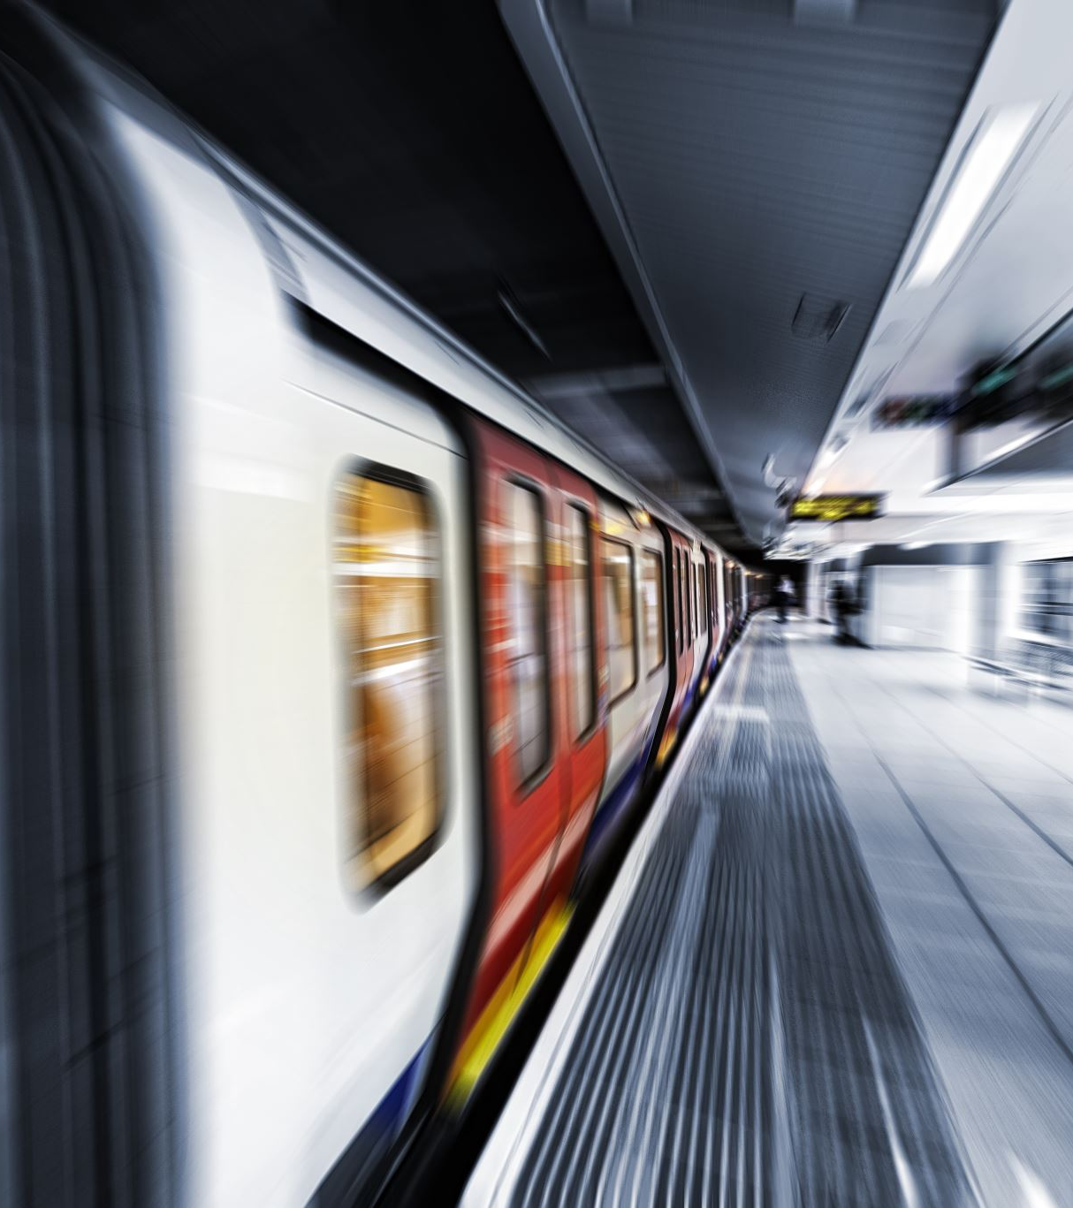
Goal
Is it possible to schedule new trains on an already busy train route?
If so, how?

Slide 7
The ATP

Slide 8
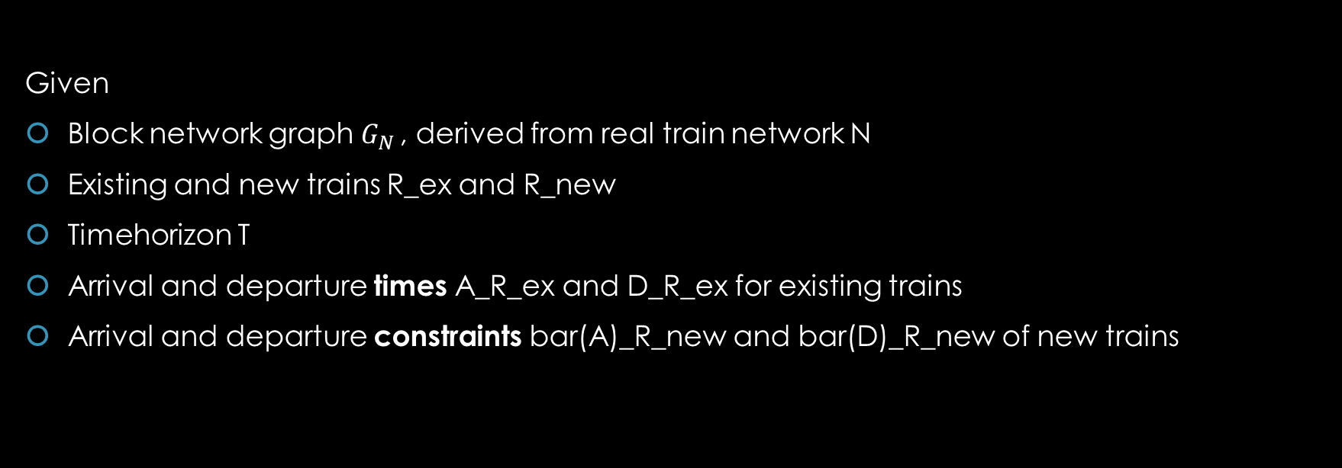
Additional Trainpath Problem (ATP)
Given
Block network graph $G_{N }$, derived from real train network N
Existing and new trains R_ex and R_new
Timehorizon T
Arrival and departure times A_R_ex and D_R_ex for existing trains
Arrival and departure constraints bar(A)_R_new and bar(D)_R_new of new trains

Slide 9
Story of the ATP
ATP is closely related to many other scheduling problems
Stems from Train Timetabling Problem

Slide 10
ATP for our Example Network

Slide 11
Signal blocks
Station blocks
Switch blocks
Notes:
Gleise
Abbildung nicht Maßstabsgetreu!

Slide 12
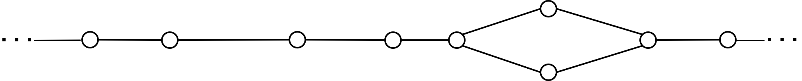
Signal blocks
Station blocks
Switch blocks
Notes:
TODO: Zeichnung und dann Graph überblenden?

Slide 13
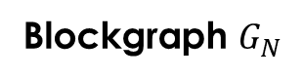
Signal blocks
Station blocks
Switch blocks
5_0
0
1
2
3
4
6
7
5_1
Blockgraph $G_{N }$
Notes:
TODO: Zeichnung und dann Graph überblenden?

Slide 14
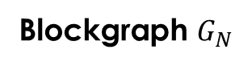
Signal
Blockgraph $G_{N }$
Station
Switch
5_0
0
1
2
3
4
6
7
5_1
Notes:
TODO: Zeichnung und dann Graph überblenden?

Slide 15
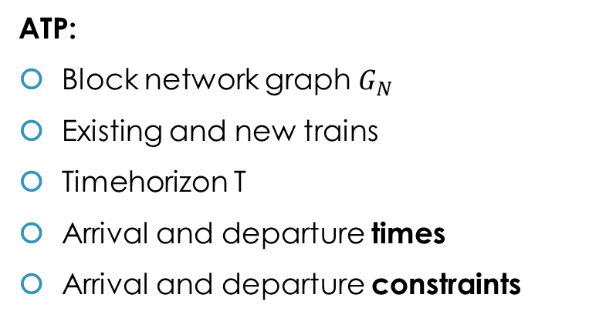
Signal
Blockgraph $G_{N }$
Station
Switch
5_0
0
1
2
3
4
6
7
5_1
ATP:
Block network graph $G_{N }$
Existing and new trains
Timehorizon T
Arrival and departure times
Arrival and departure constraints
Notes:
TODO: Zeichnung und dann Graph überblenden?

Slide 16
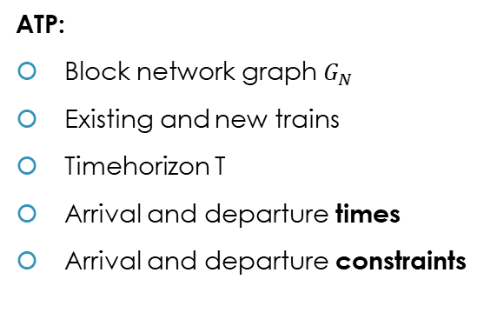
Signal
Blockgraph G_N
Station
Switch
5_0
0
1
2
3
4
6
7
5_1
Three Existing Trains
and Three New Trains
ATP:
Block network graph $G_{N }$
Existing and new trains
Timehorizon T
Arrival and departure times
Arrival and departure constraints
Fast Trains
ICE 0
Slow Trains
RE 0
RE 1
ICE 1 (f1)
ICE 2 (f2)
RE 2 (s0)
Notes:
TODO: Zeichnung und dann Graph überblenden?

Slide 17
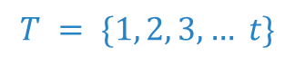
Signal
Blockgraph G_N
Station
Switch
5_0
0
1
2
3
4
6
7
5_1
ATP:
Block network graph $G_{N }$
Existing and new trains
Timehorizon T
Arrival and departure times
Arrival and departure constraints
Time Horizon
$$T = \{1, 2, 3, … t\}$$
Notes:
TODO: Zeichnung und dann Graph überblenden?

Slide 18
Signal
Blockgraph G_N
Station
Switch
5_0
0
1
2
3
4
6
7
5_1
Arrival and Departure Times
ATP:
Block network graph $G_{N }$
Existing and new trains
Timehorizon T
Arrival and departure times
Arrival and departure constraints
0
2
5_x
7
Trains
 | A | D | A | D | A | D | A | D
ICE 0 | - | 1 | 4 | 5 | 10 | 20 | 23 | -
RE 0 | - | 11 | 16 | 18 | 26 | 30 | 33 | -
RE 1 | - | 31 | 36 | 38 | 46 | 50 | 53 | -
Notes:
TODO: Zeichnung und dann Graph überblenden?

Slide 19
Signal
Blockgraph G_N
Station
Switch
5_0
0
1
2
3
4
6
7
5_1
Arrival and Departure Constraints
ATP:
Block network graph $G_{N }$
Existing and new trains
Timehorizon T
Arrival and departure times
Arrival and departure constraints
0
2
5_x
7
Trains
 | A | D | A | D | A | D | A | D
ICE 0 | - | 1 | 4 | 5 | 10 | 20 | 23 | -
RE 0 | - | 11 | 16 | 18 | 26 | 30 | 33 | -
RE 1 | - | 31 | 36 | 38 | 46 | 50 | 53 | -
RE 2 | - | 5 | 10 | 12 | 20 | 24 | 27 | -
ICE 1 | - | 15 | 18 | 19 | 24 | 34 | 37 | -
ICE 2 | - | 25 | 28 | 29 | 34 | 44 | 47 | -
Notes:
TODO: Zeichnung und dann Graph überblenden?

Slide 20
Two models

Slide 21
Mixed Integer Program
“Simple“ model for ATP
Binary variables

Slide 22
MIP Structure
Variables for
arrival and departure at each block
train order
block usage
Minimizing:
sum of deviations from (planned) arrival and departure times
Notes:
TODO: Print MIP?

Slide 23
Time-Expanded Network
Motivation: Algorithmic method vs “black box“ LP-solver
Idea:
Construct copies of the network for each timestep
Solve ATP by finding feasible paths
Finding feasible paths by deleting “blocked“ edges
Notes:
Motivation
Idea
Algorithms
Parts of algorithms shown for the example

Slide 24
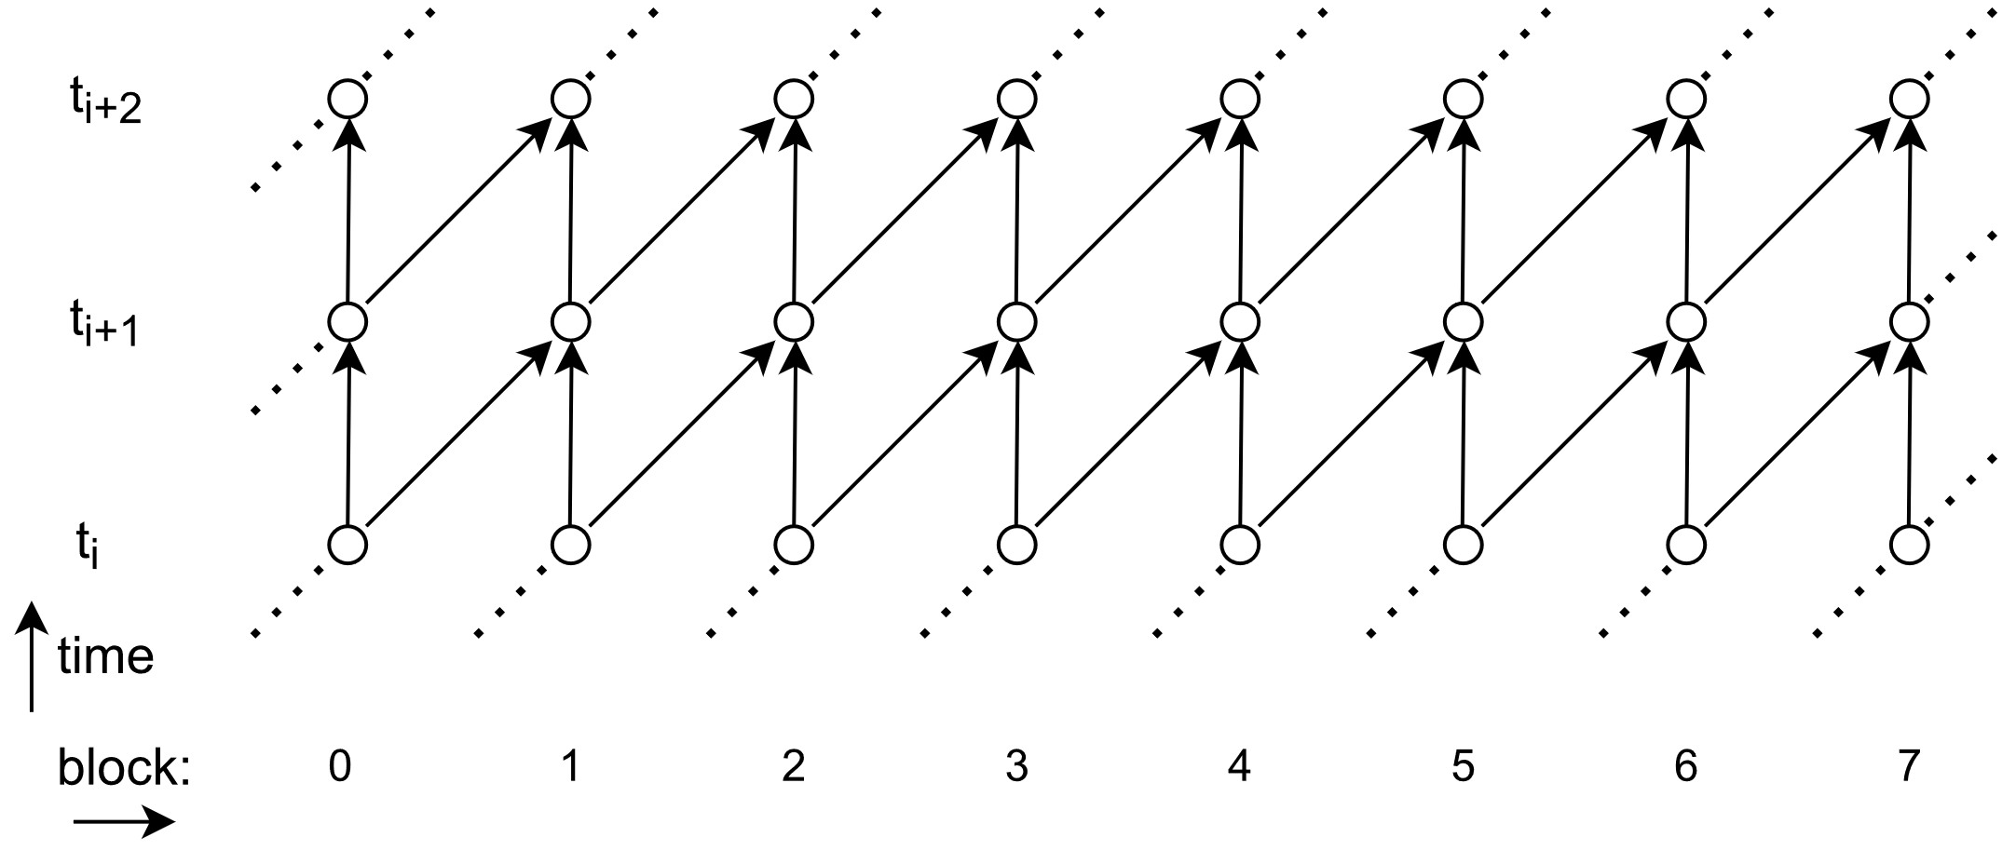
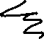
Signal
Blockgraph G_N
Station
Switch
0
2
5_x
7
Trains
 | A | D | A | D | A | D | A | D
ICE 0 | - | 1 | 4 | 5 | 10 | 20 | 23 | -
5_0
0
1
2
3
4
6
7
5_1

Slide 25
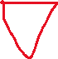

Signal
Blockgraph G_N
Station
Switch
5_0
0
1
2
3
4
6
7
5_1

Slide 26
Finding a Path
TEN can only insert one new train at once
Construct TEN for each new train
A feasible path in the TEN is a feasible train path (i.e. timetable)
How to find such?

Slide 27
Edge Deletion
Already running trains resemble paths in the TEN
Delete edges that are not usable for the new train
Simple and
Advanced edge deletion

Slide 28
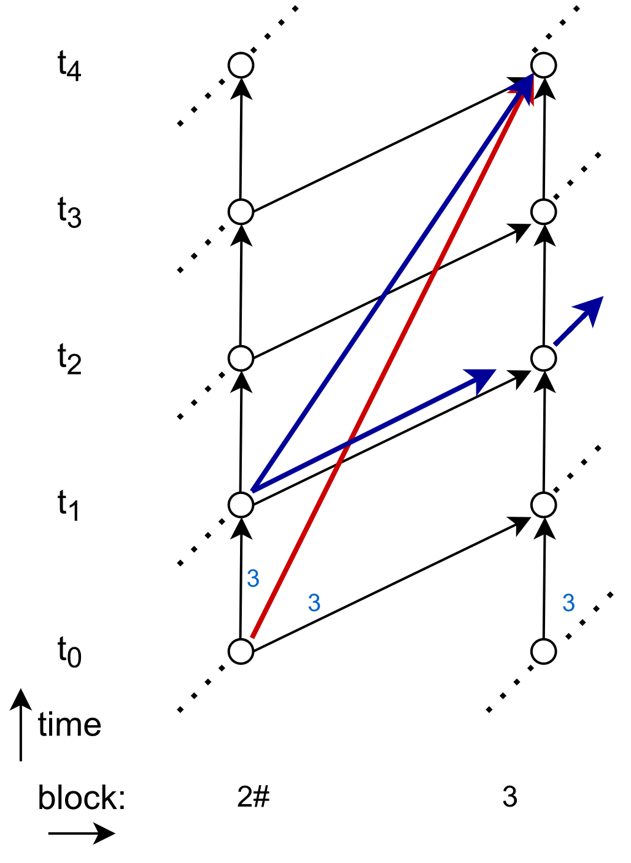
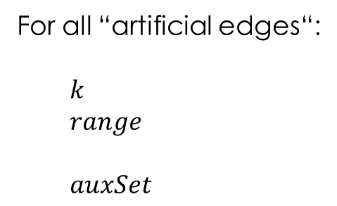
Advanced Edge Deletion
For all “artificial edges“:
$k$
$range$
$auxSet$

Slide 29
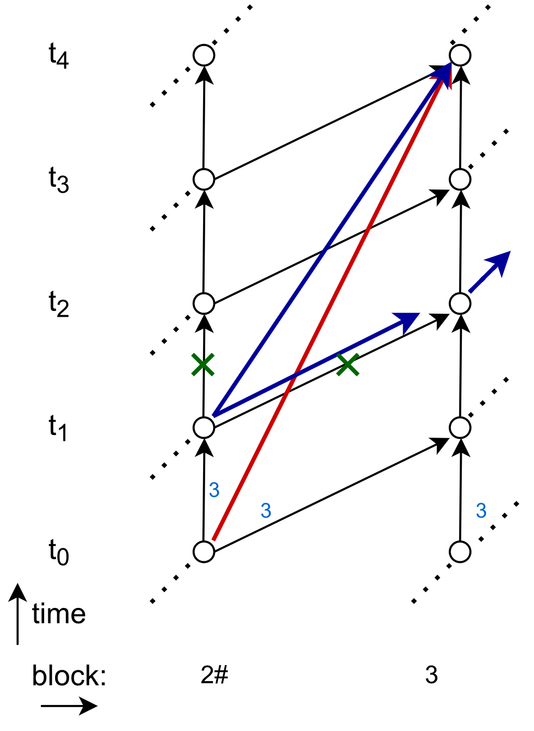
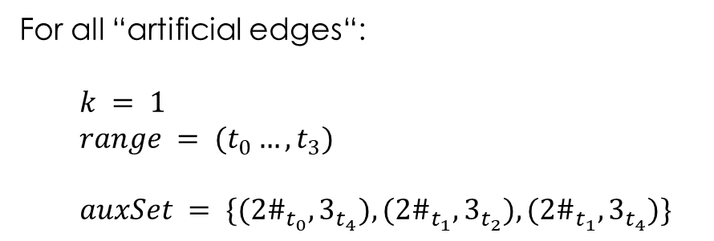
Advanced Edge Deletion
For all “artificial edges“:
$k = 1$
$range = (t_{0}…, t_{3})$
$auxSet = \{({2\#}_{t_{0}},3_{t_{4}}), ({2\#}_{t_{1}},3_{t_{2}}), ({2\#}_{t_{1}},3_{t_{4}})\}$

Slide 30
Simple Edge Deletion

Slide 31
Storyboard (Summary of What and How)
Motivation
Goal
Train Timetabling
ATP
Two Models
MIP
TEN
Edge Deletion

Slide 32

Programming a Framework

Slide 33
Generated Network / Train Data
Network Data
Properties
Network
Generator
Feasibility
Check
TEN
New Timetable
Network Data
Main Test Script
MIP

Slide 34
MIP
global
All new trains at once
Network Data
Main Test Script
MIP
iterative
One new train
at a time
TEN
iterative
One new train
at a time

Slide 35

Results

Slide 36
Solving the ATP
Blocks | Stations | Ex. Trains | New Trains
10 | 3 | 3 | 3
10 | 3 | 5 | 5
20 | 3 | 3 | 3
20 | 3 | 5 | 5
20 | 5 | 5 | 5
30 | 3 | 3 | 3
30 | 3 | 5 | 5
30 | 5 | 5 | 5
30 | 7 | 7 | 7
40 | 3 | 3 | 3
40 | 5 | 5 | 5
40 | 7 | 7 | 7
50 | 3 | 3 | 3
50 | 5 | 5 | 5
50 | 7 | 7 | 7
50 | 10 | 10 | 10
Test cases with different
network size
stations
existing trains
new trains

Slide 37
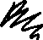
Computational Results

Slide 38

Conclusion

Slide 39
Take Aways
Problem becomes increasingly harder for larger instances
Lots of potential for improvement
MIP
TEN

Slide 40
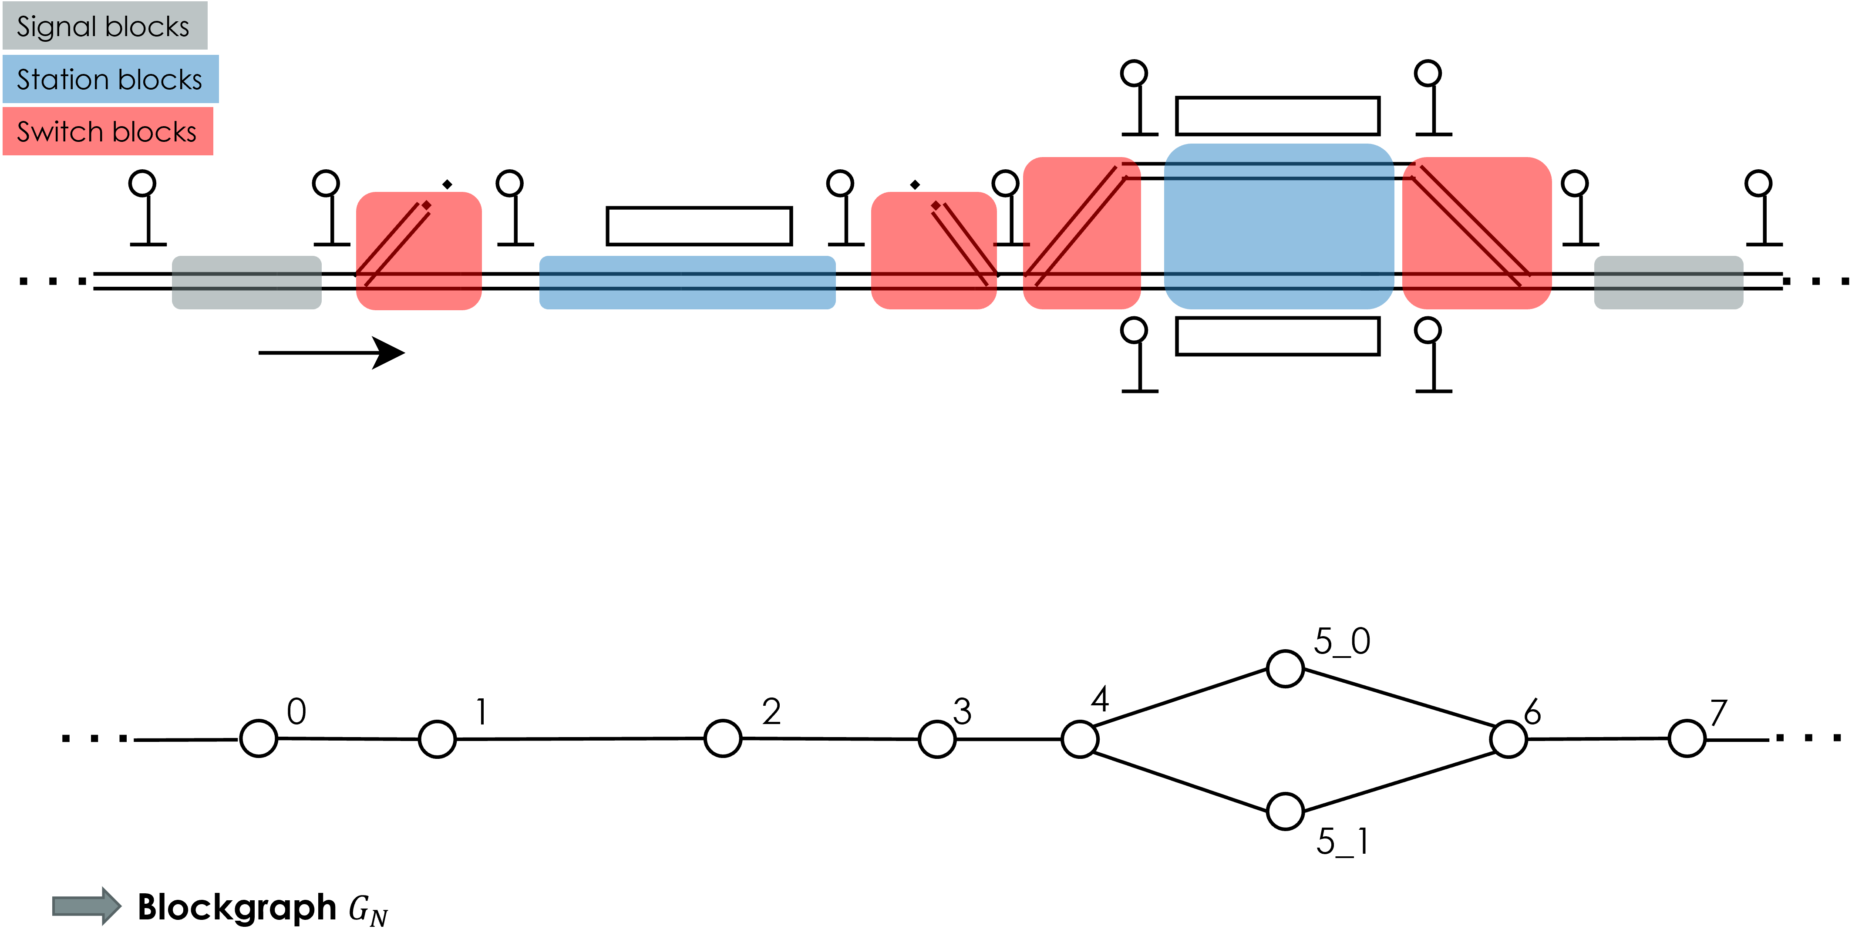
What about our example network??

Slide 41
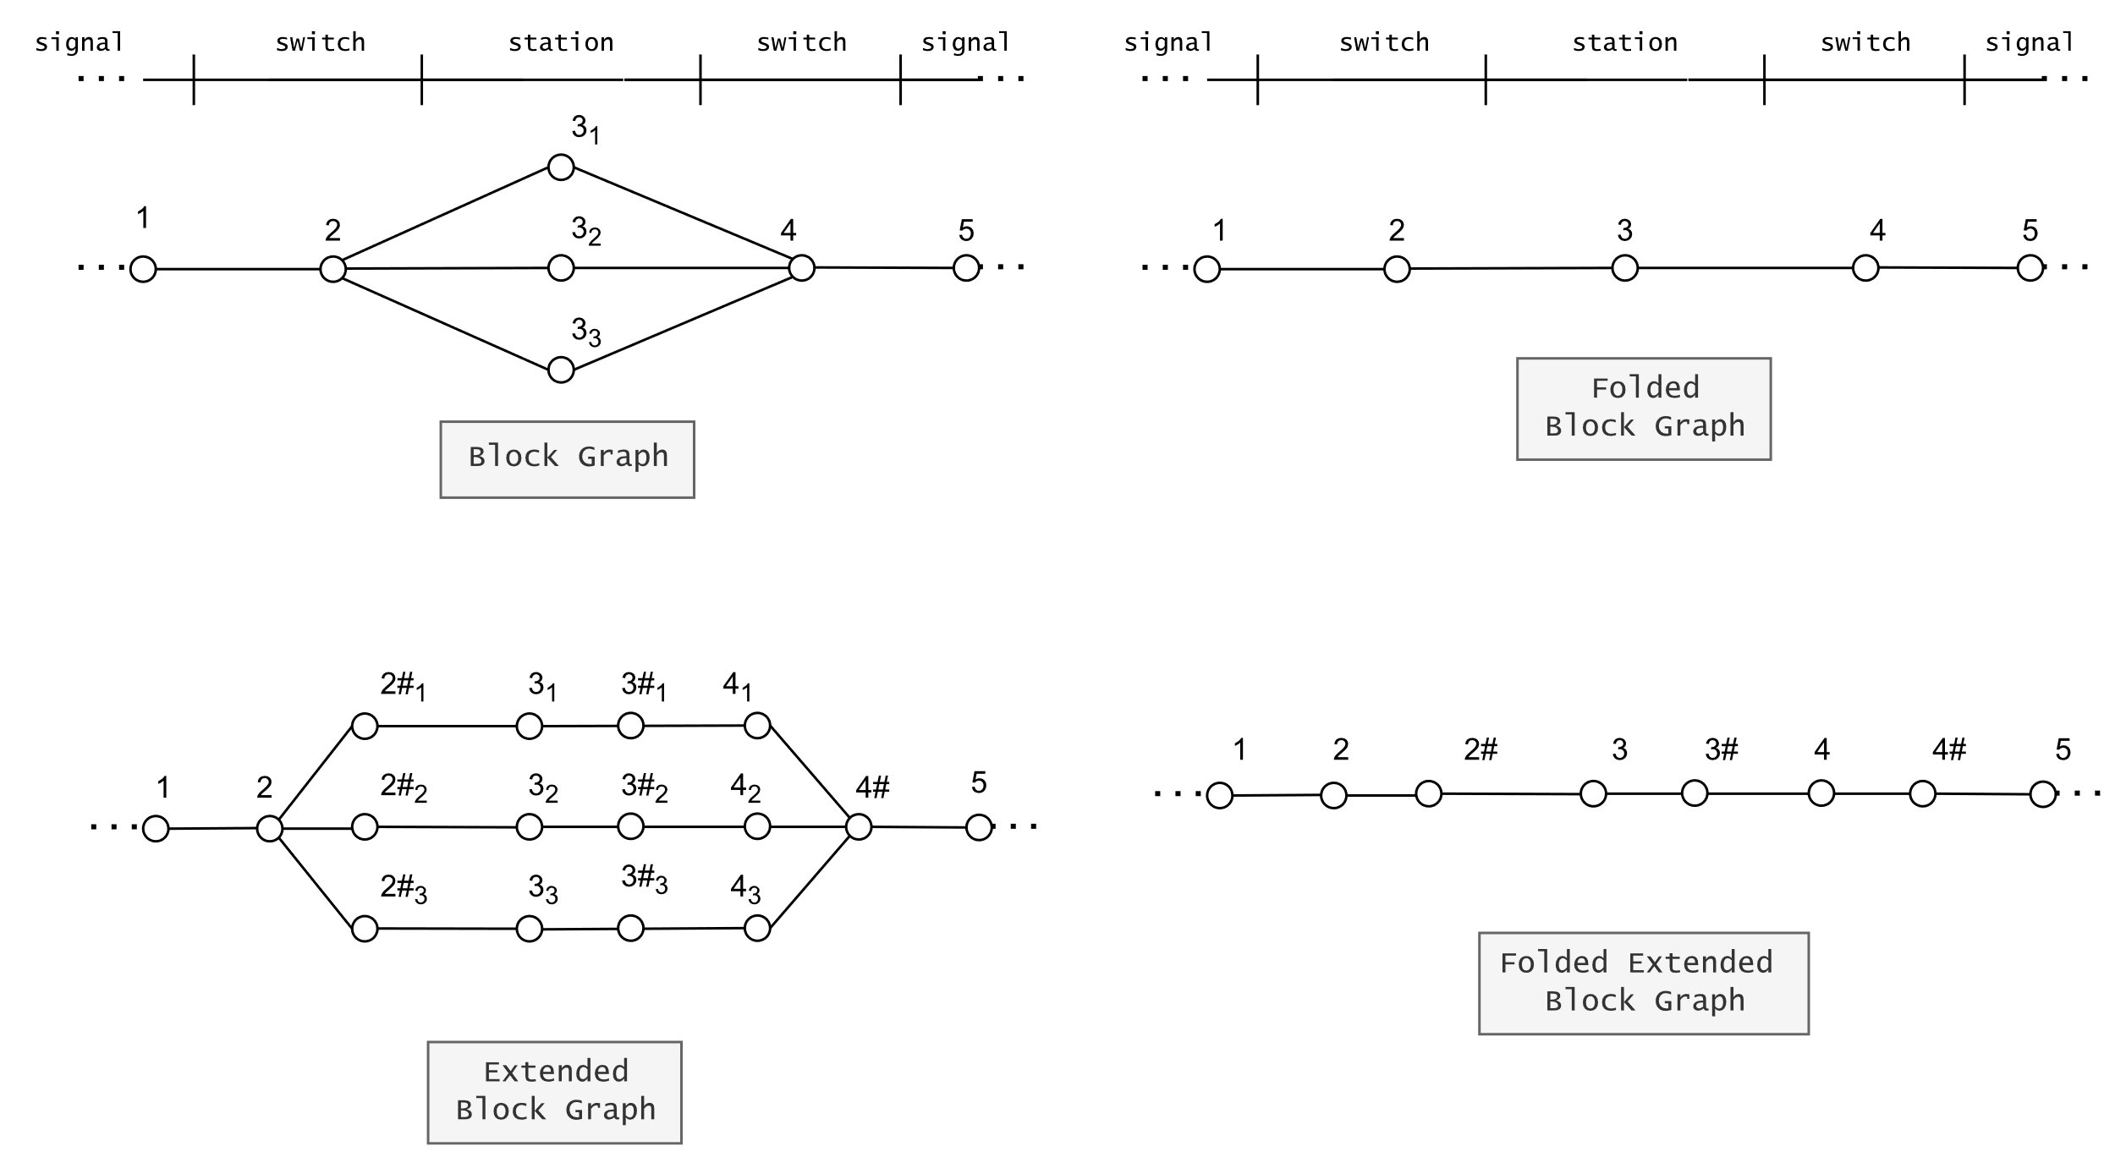

Slide 42
Motivation
Every day 23505 trains are traveling on the german railway network
1109 million km travelled
1,203 billion* passengers per year
3,9 million passengers per day
A high potential for optimisiation!
Notes:
\* english Billion = german Milliarden
Source: Deutsche Bahn Daten und Fakten 2021, https://www.deutschebahn.com/resource/blob/7537106/7d38dfcb4de528171002c09ae29ba705/DuF2021-data.pdf

